Slide 1
Colorado Outward
Bound School
By:Reed Frey

Slide 2
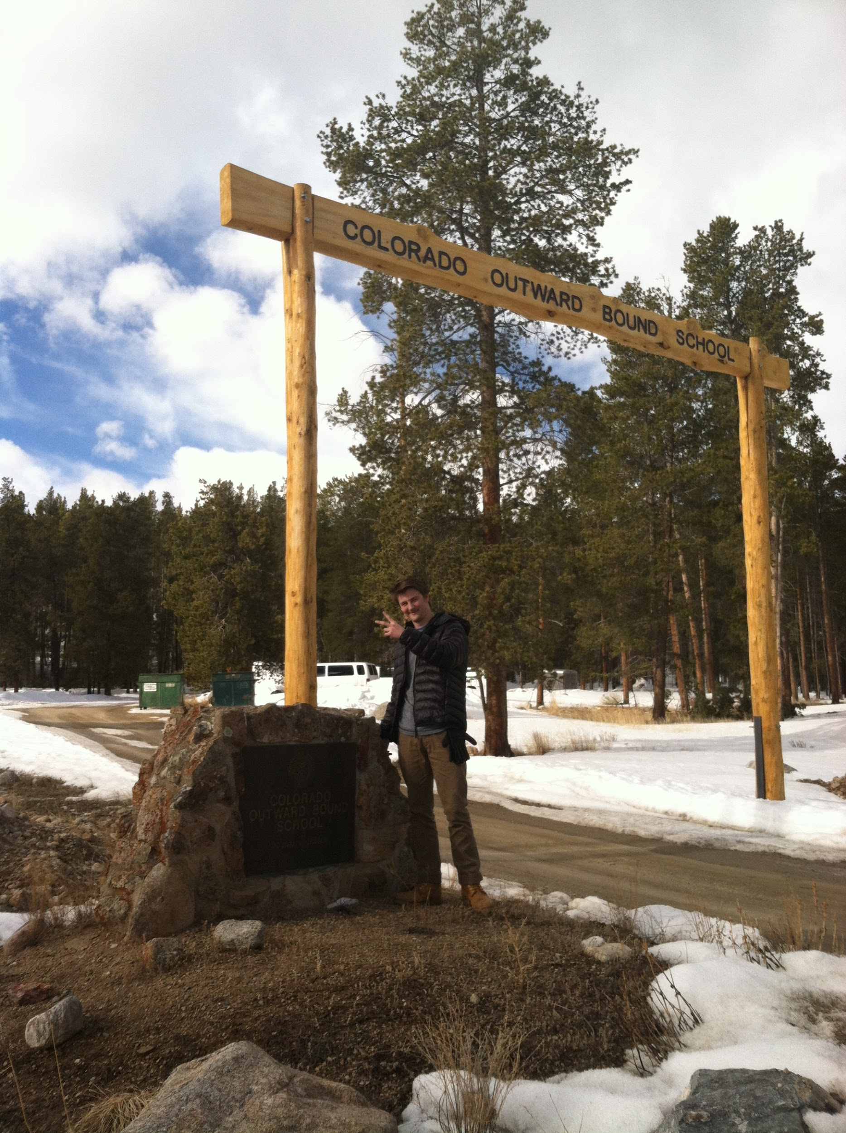

Slide 3
During three weeks of of school in March
Of 2016.
Which I being very fortunate spent it at the Colorado Outward Bound School in Leadville, CO.

Slide 4
During my time there I worked primarily with my uncle in the main kitchen.

Slide 5
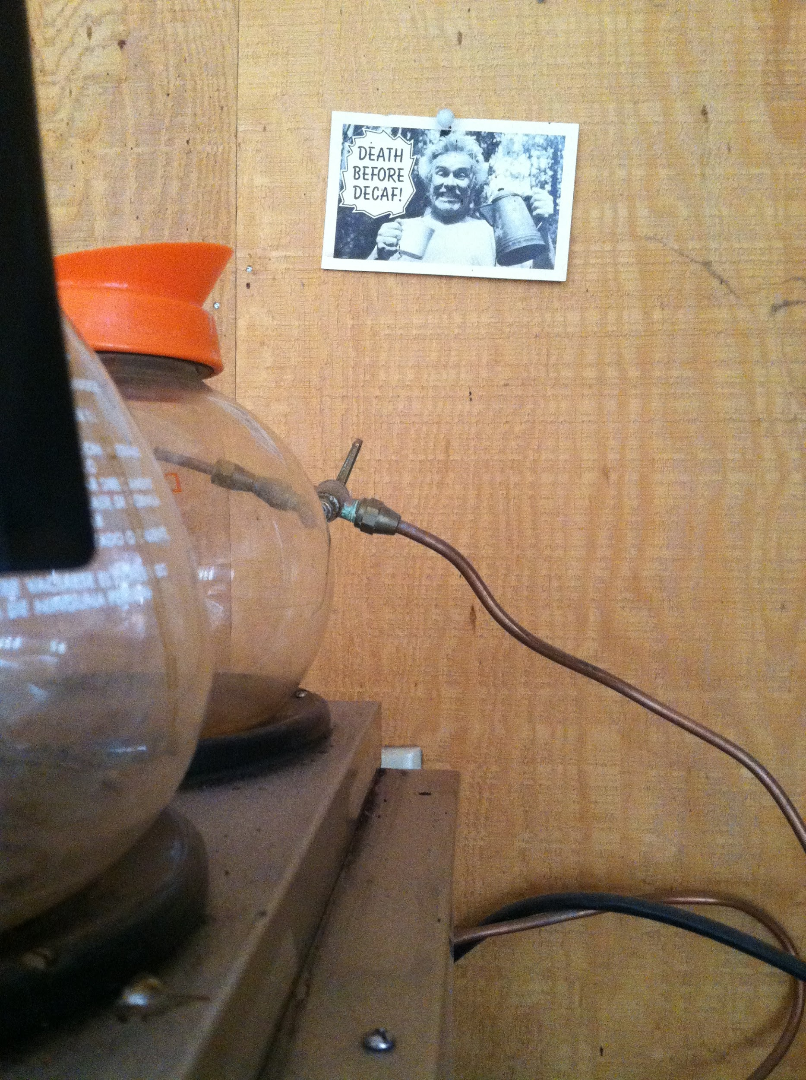

Slide 6
Which had an incredible room full images from the past many years of Outward Bound. It showed a few images of the first crew to have participated in the Outward Bound School.

Slide 7
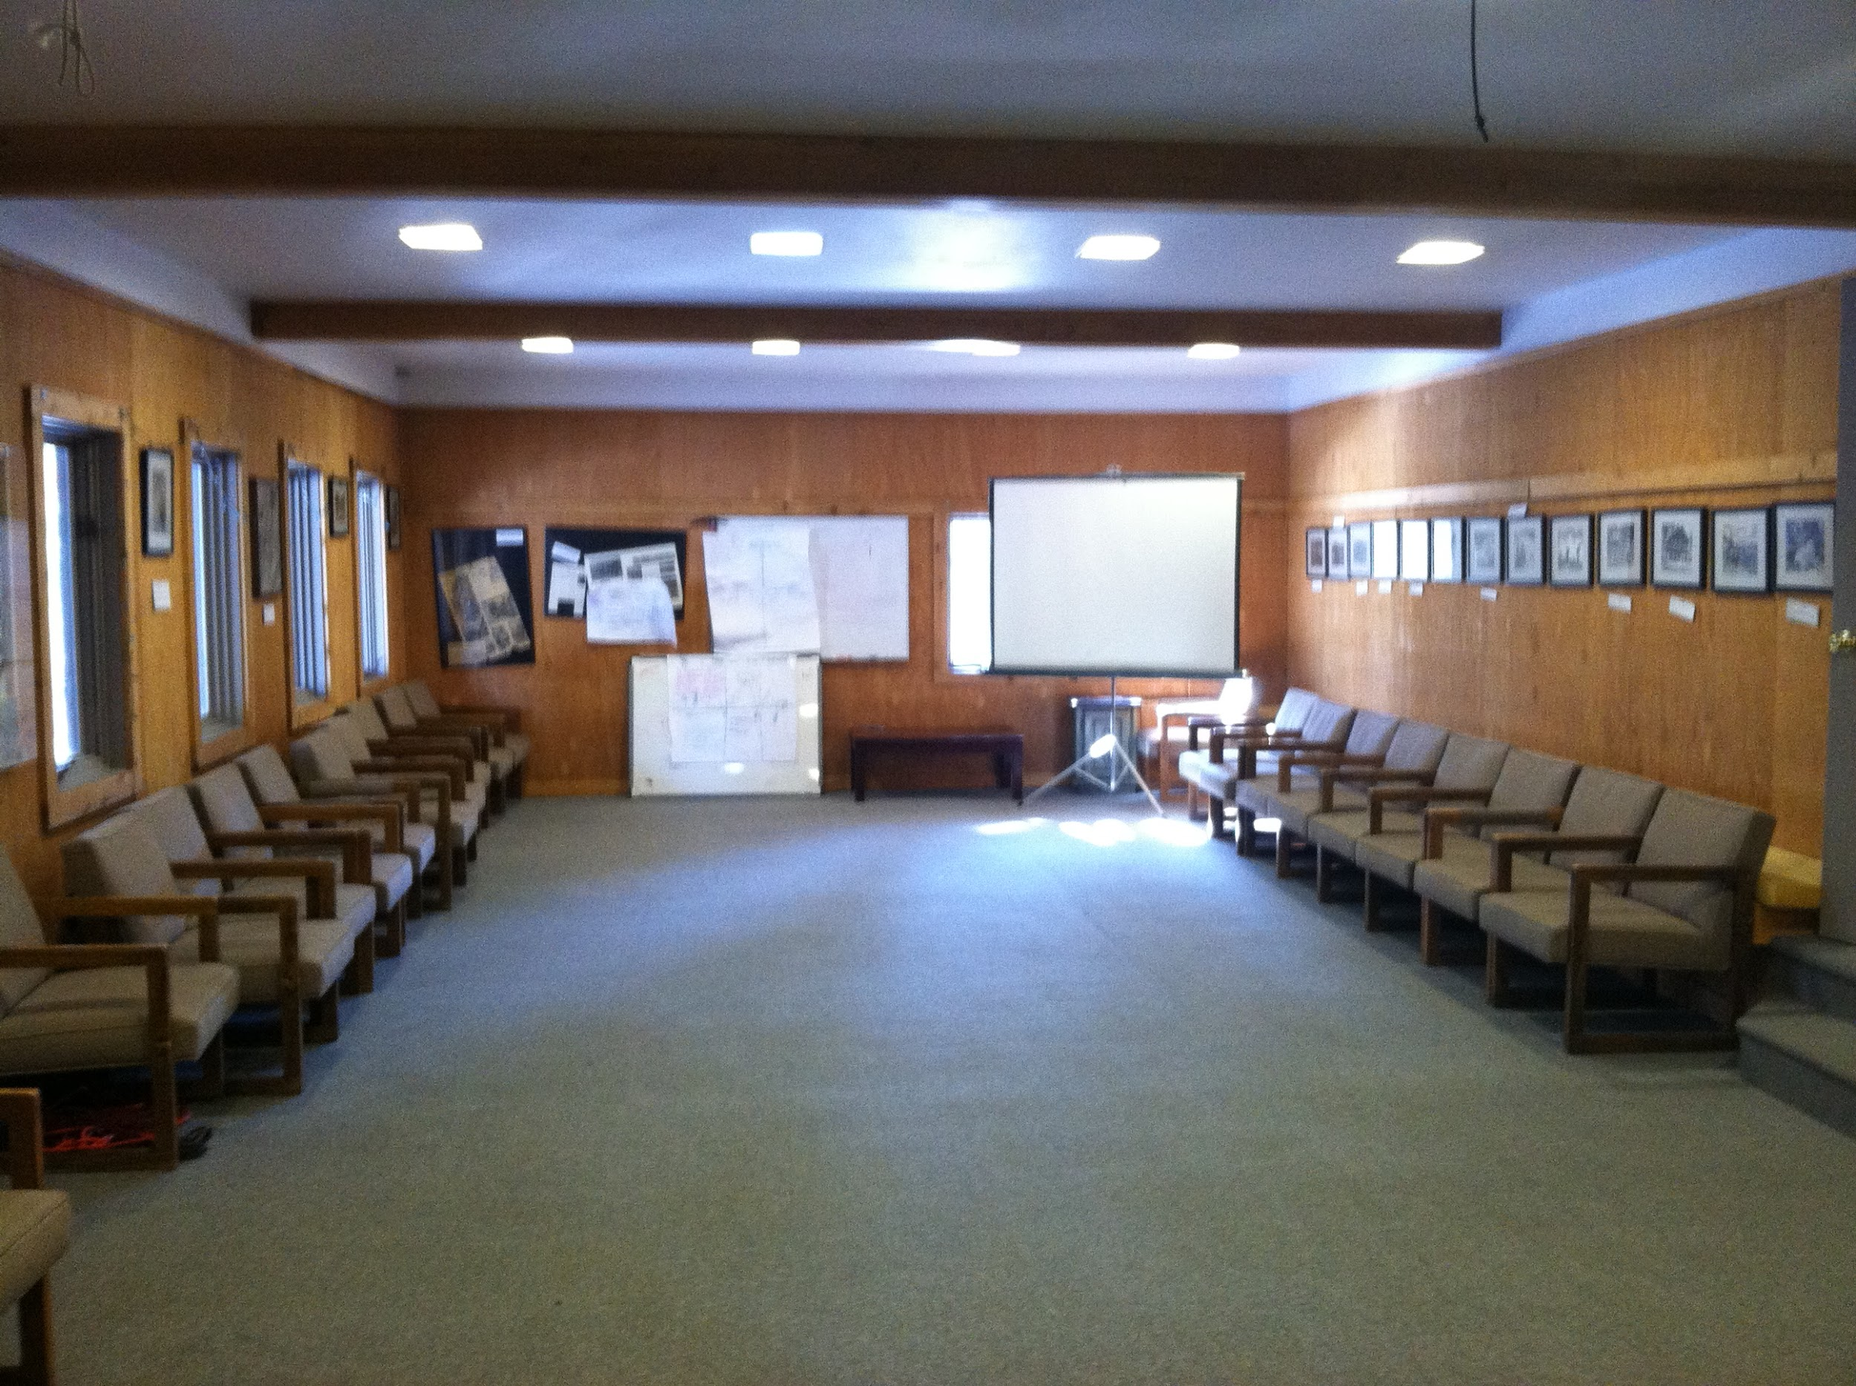

Slide 8
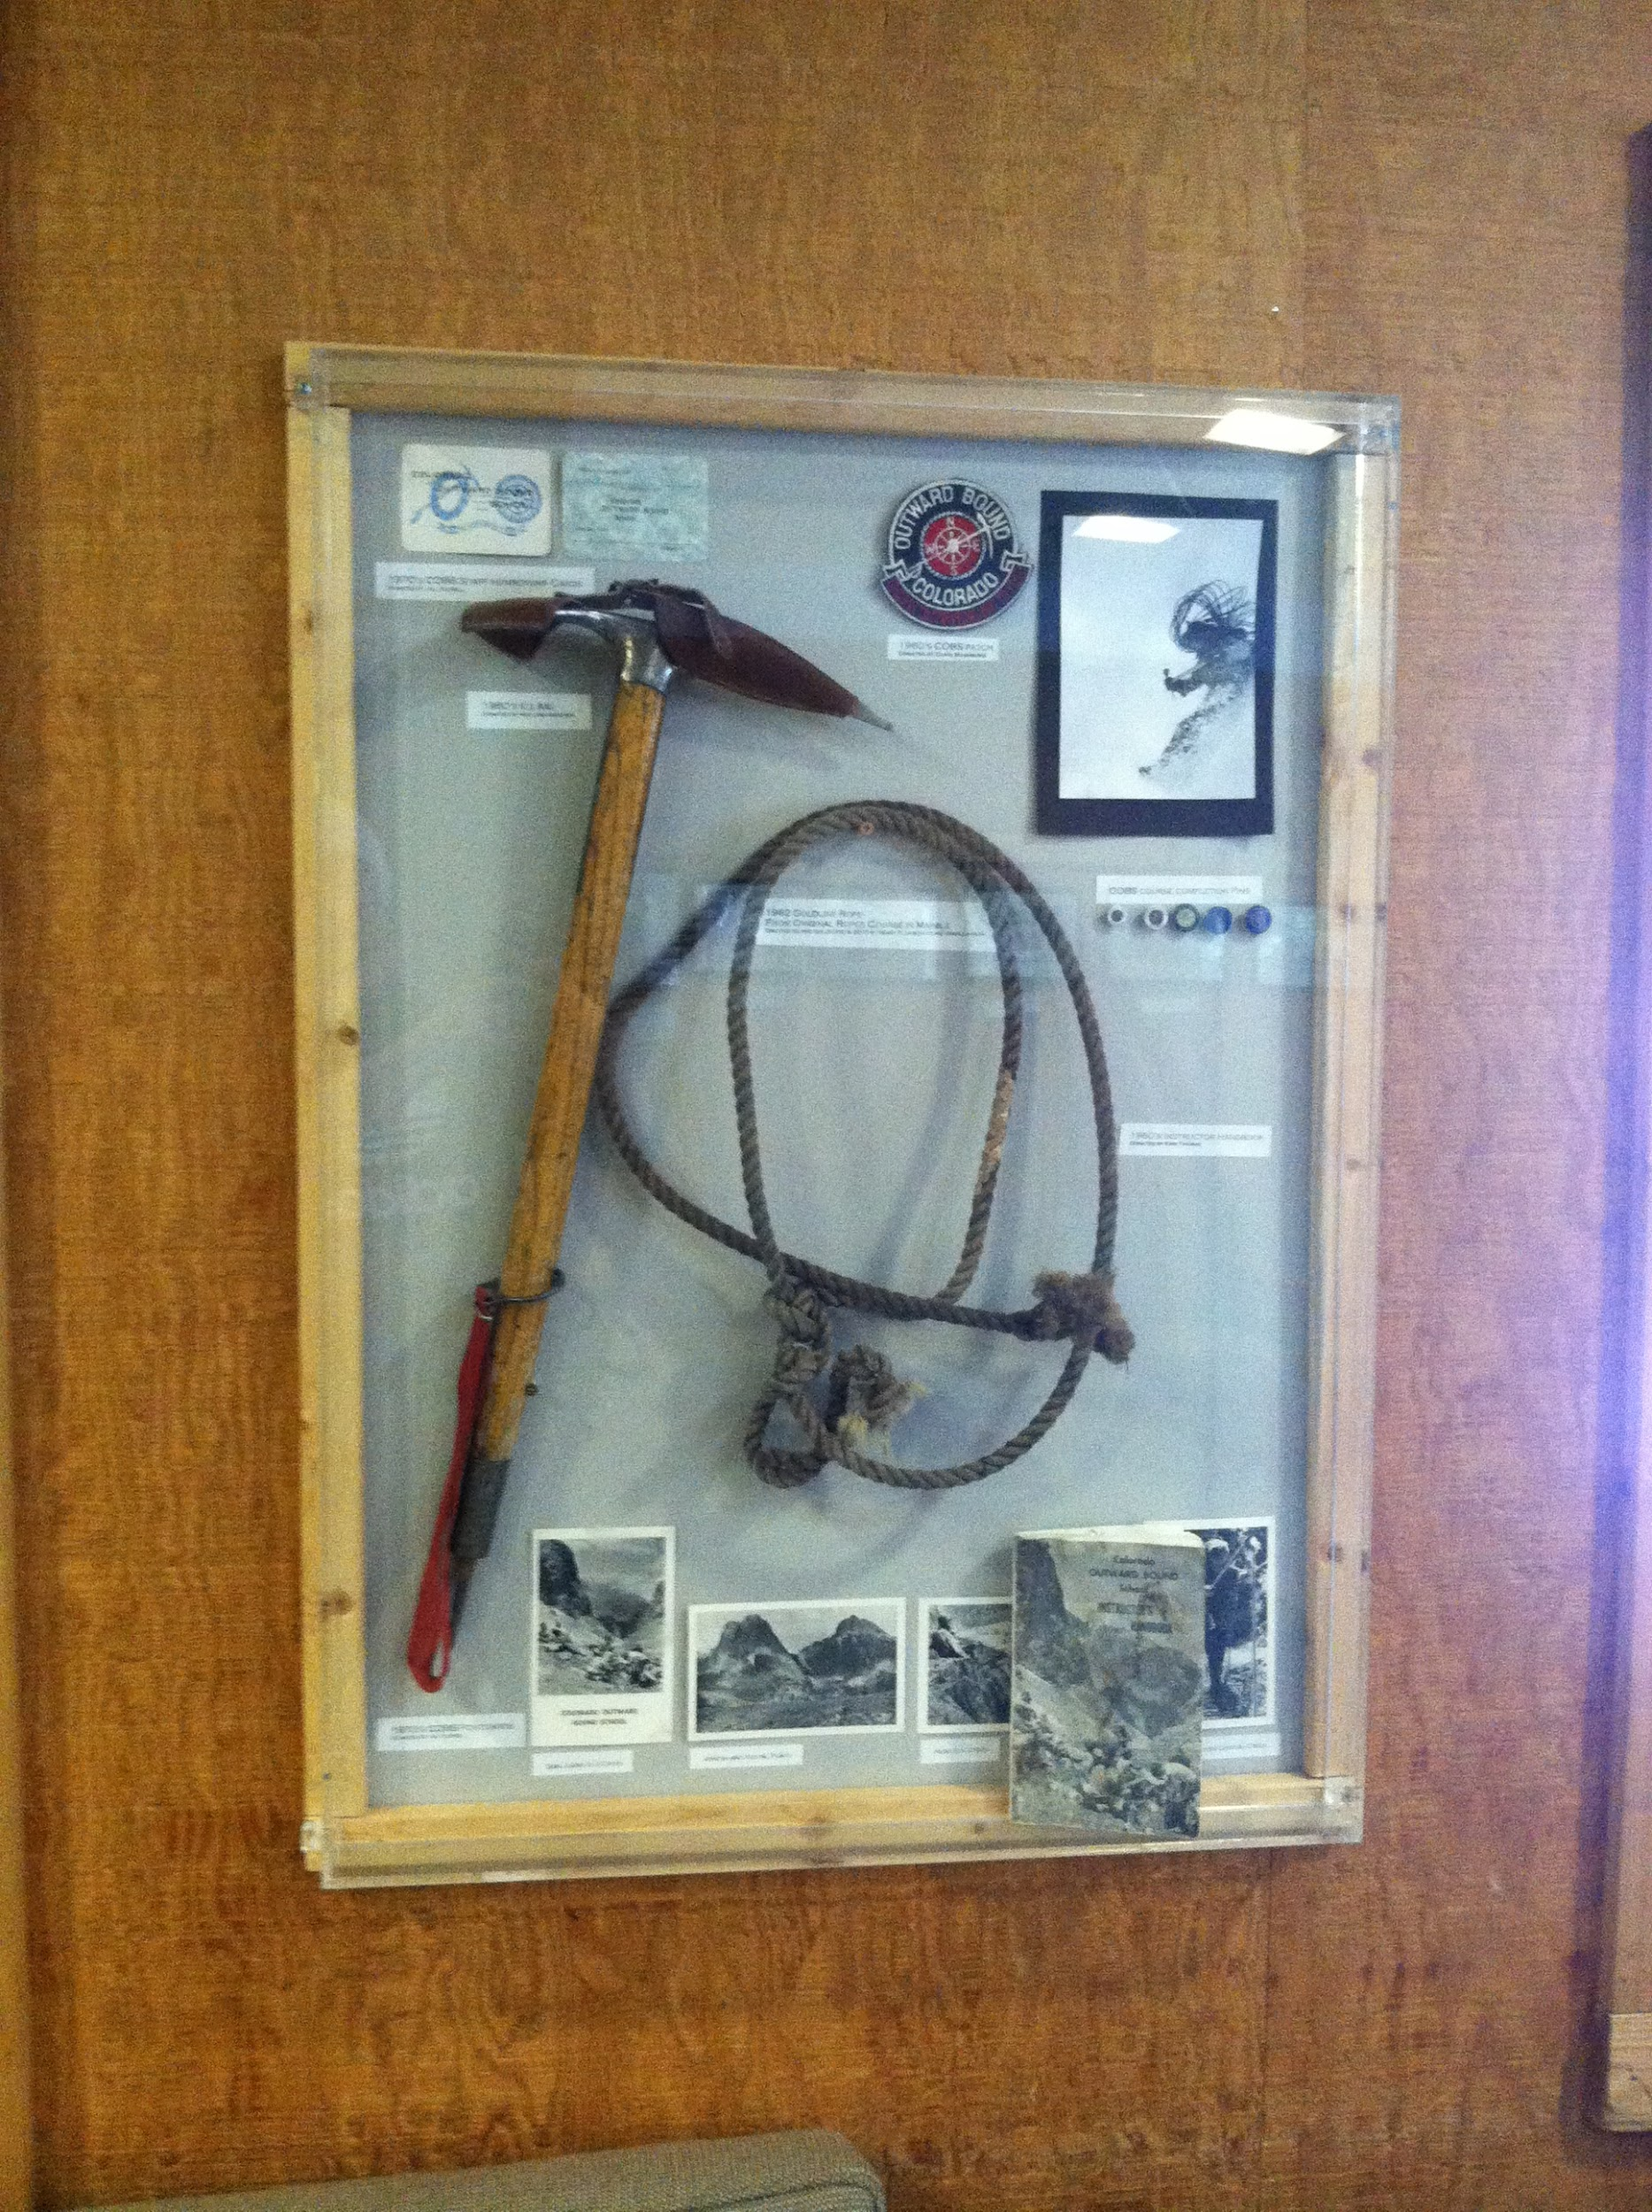

Slide 9
I was also able to go to Denver for a concert and walked around the old and neat town of Leadville.

Slide 10
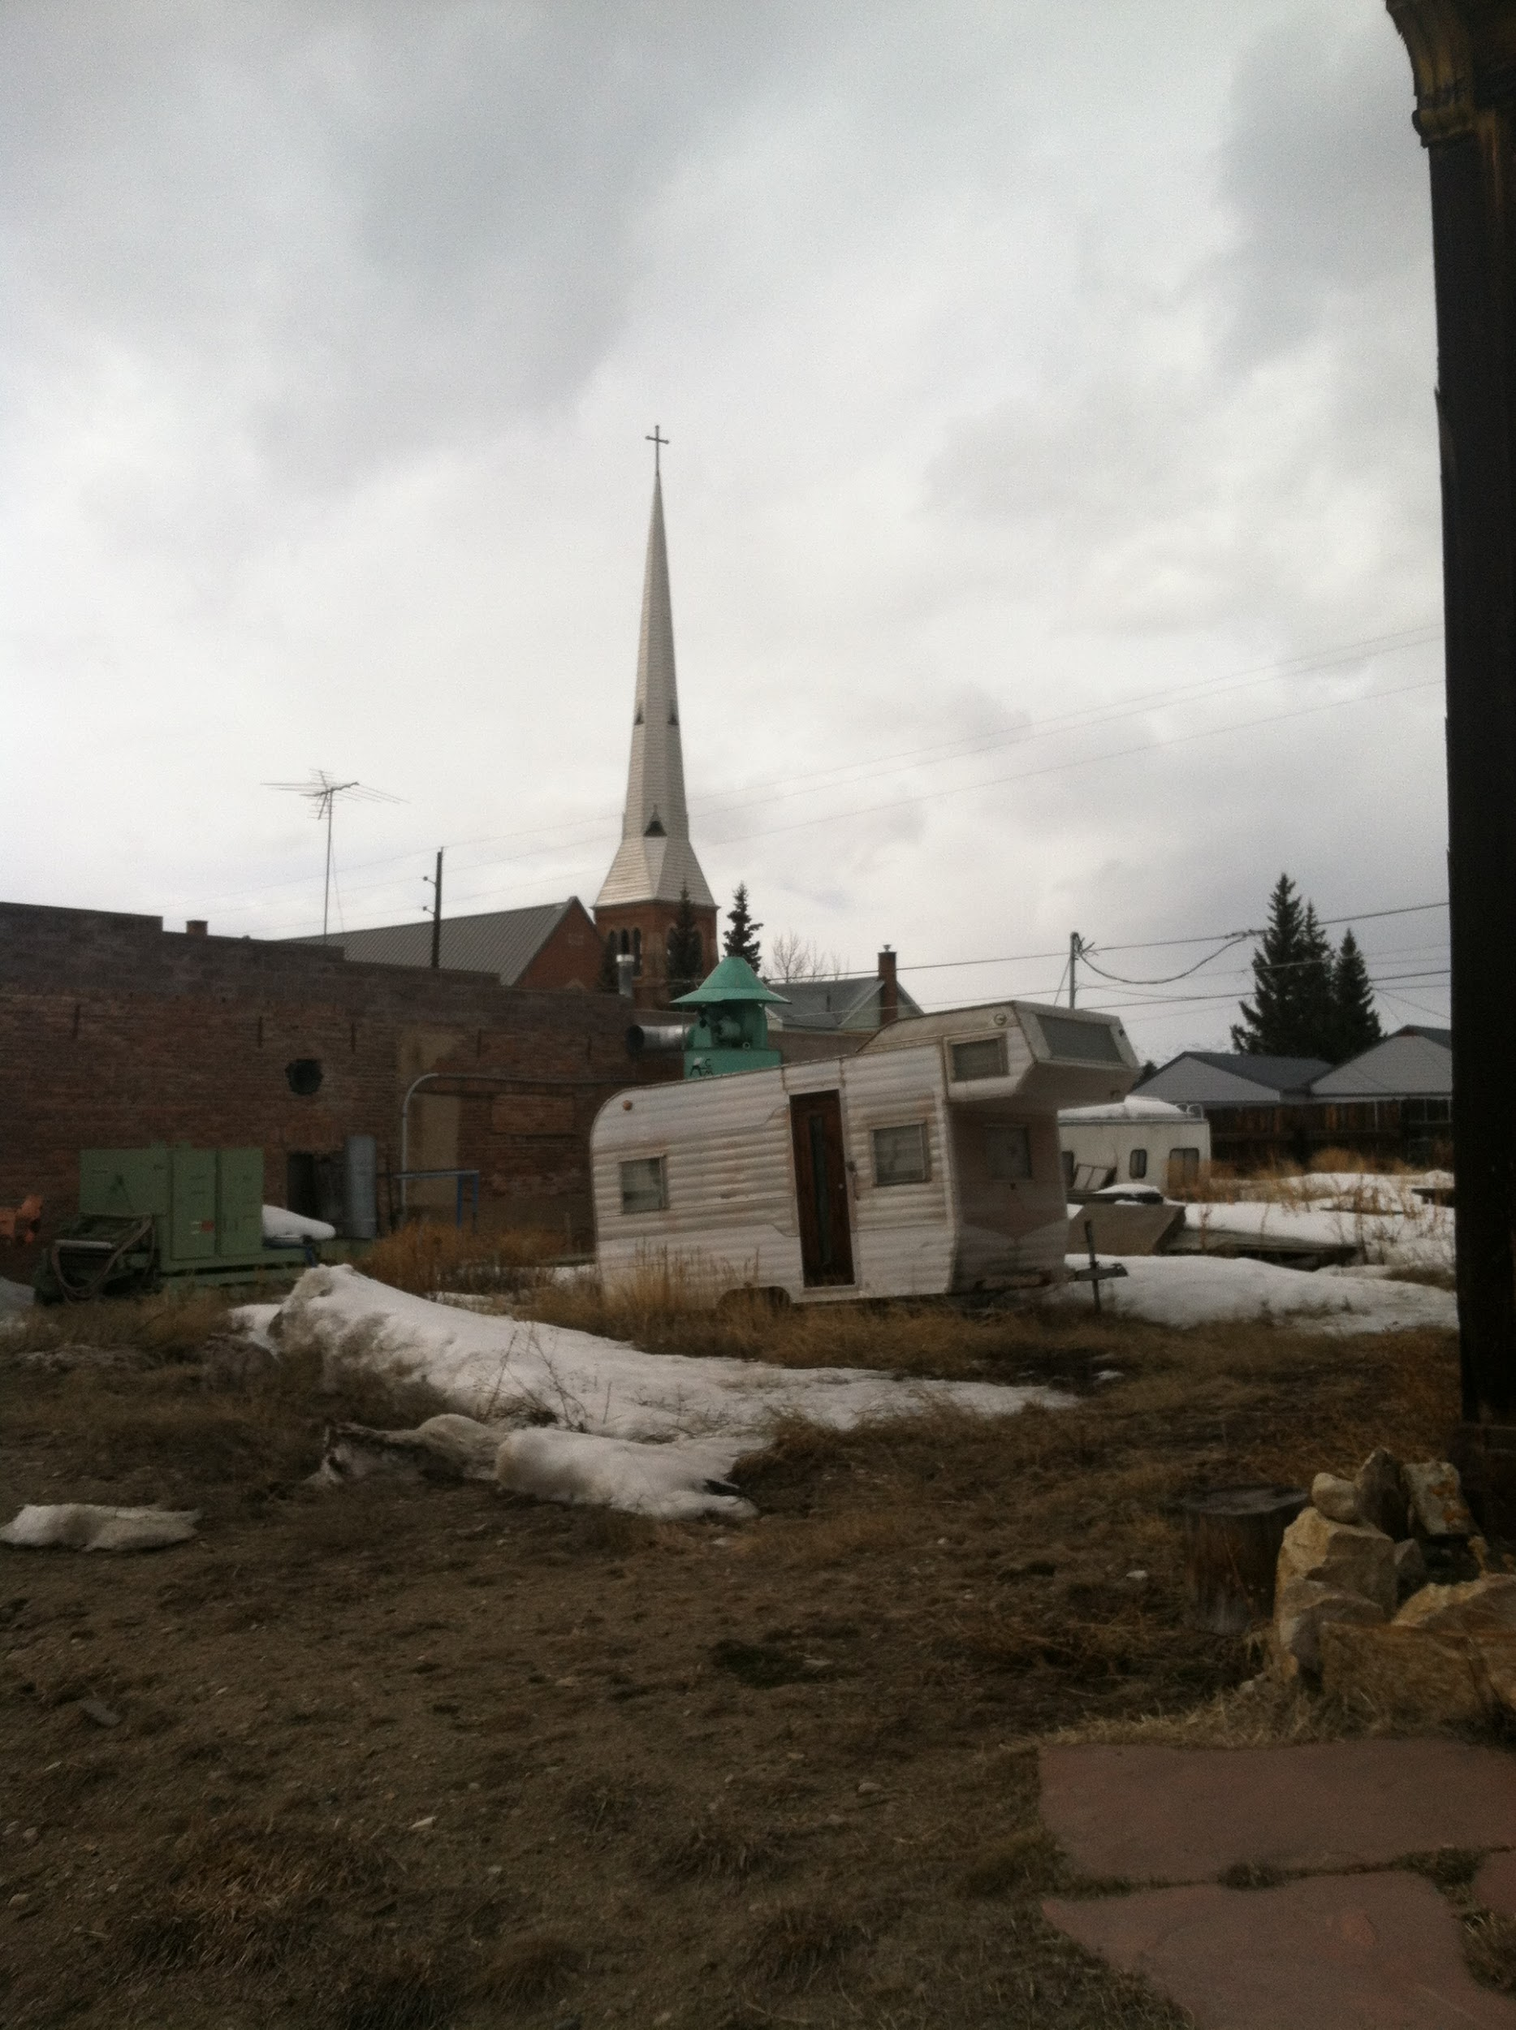

Slide 11
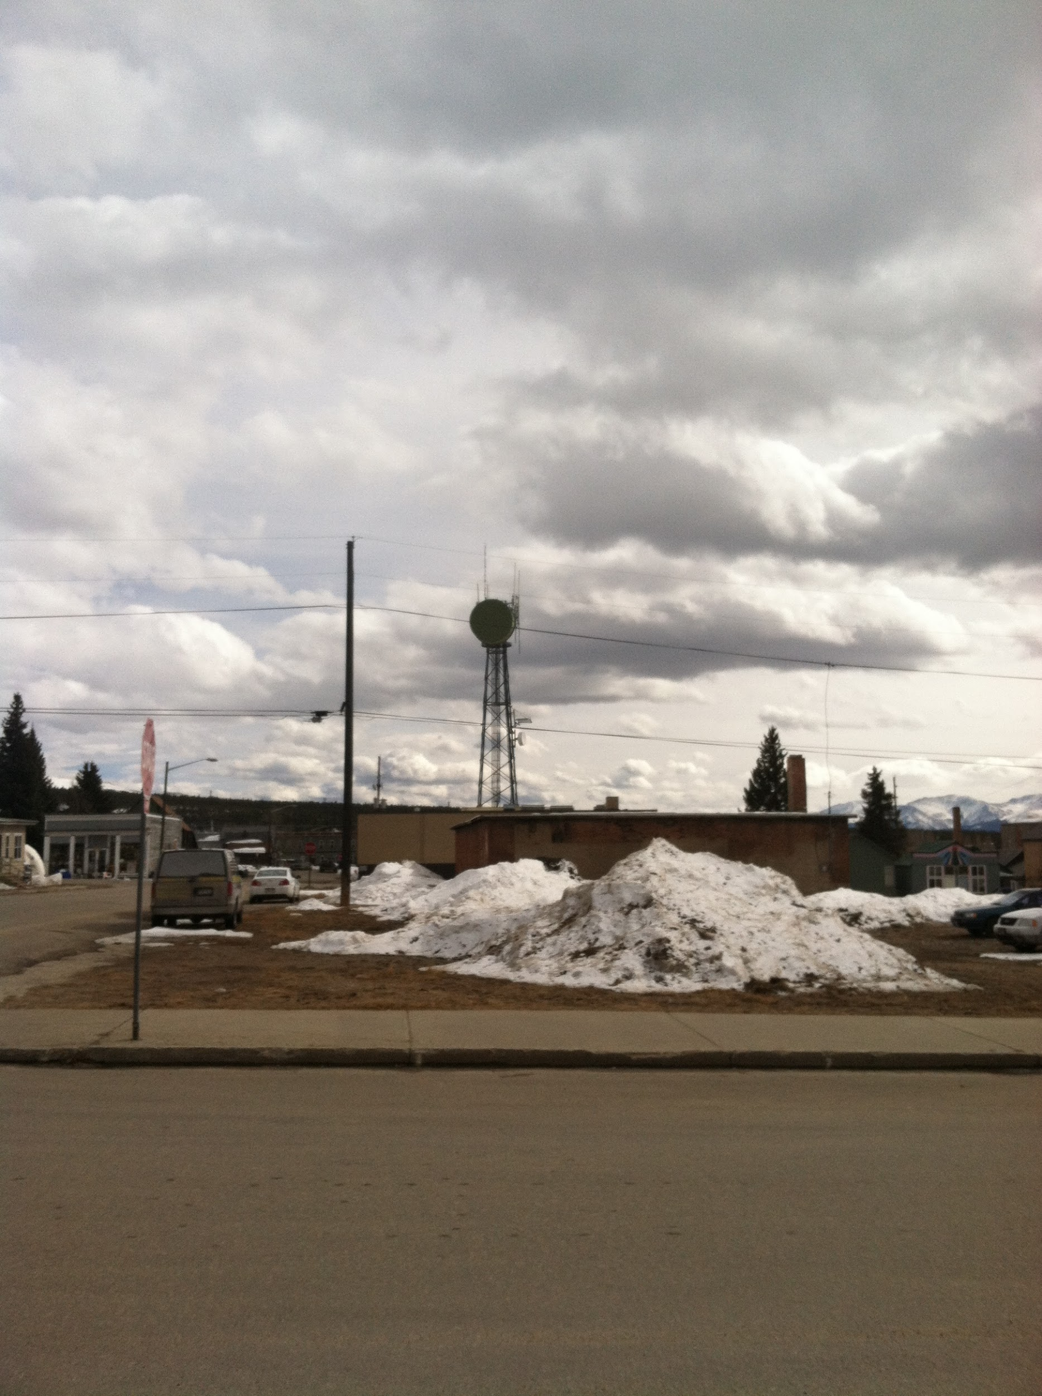

Slide 12
I had an unforgettable experience worked in just an awesome place in an awesome area!

Slide 13
I hope to soon revisit and continue to make new connections!

